Slide 1
9.4
Approximation problems: Fourier series
In this section we shall use results about orthogonal projections in inner product spaces to solve problems that involve approximating a given function by simpler function.
Such problems arise in a variety of engineering and scientific applications.

Slide 2
Best Approximations (1/2)
All of the problems that we will study in this section will be special cases of the following general problem.
Approximation problem
  Given a function f that is continuous on an interval [a,b], find the “best possible approximation” to f using only functions from a specified subspace W of C[a,b].

Slide 3
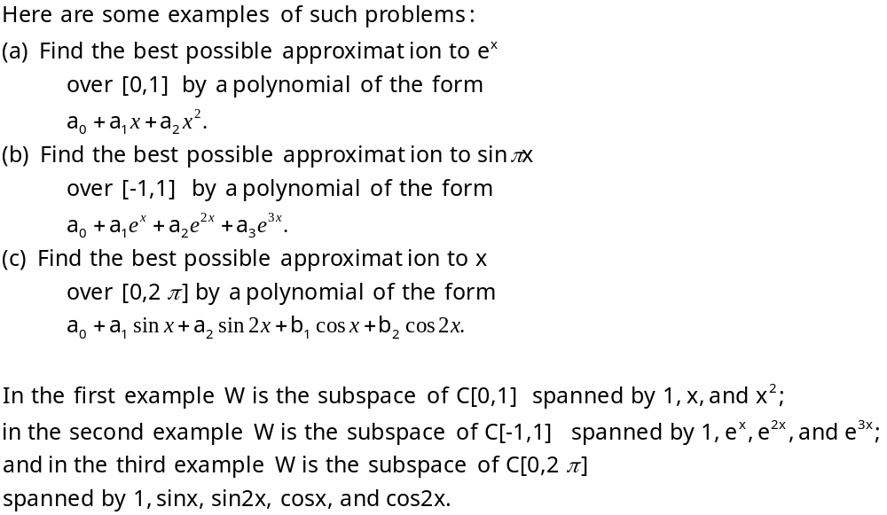
Best Approximations (2/2)

Slide 4
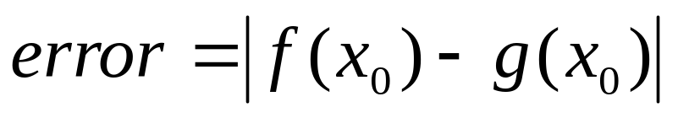
Measurements of error (1/6)
We must make the phrase “best approximation over [a,b]” mathematically precise: to do this we need a precise way of measuring the error that results when one continuous function is approximated by another over [a,b].
if we were concerned only with approximating f(x) at a single point x₀, then the error at x₀ x by an approximation g(x) would be simply
Sometimes called the deviation between f and g at x₀ (Figure 9.4.1).

Slide 5
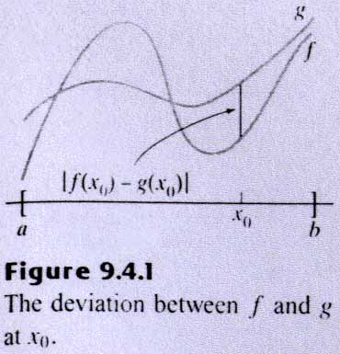
Figure 9.4.1
Go back

Slide 6
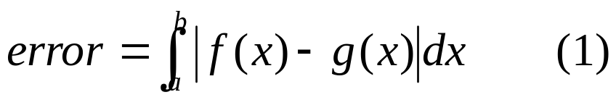
Measurements of error (2/6)
Consequently, in one part of the interval an approximation g₁ to f may have smaller deviations from f than an approximation g₂ to f, and in another part of the interval it might be the other way around.
How do we decide which is the better overall approximation?
What we need is some way of measuring the overall error in an approximation g(x).
One possible measure of overall error is obtained by integrating the deviation |f(x)-g(x)| over the entire interval [a,b]; that is,

Slide 7
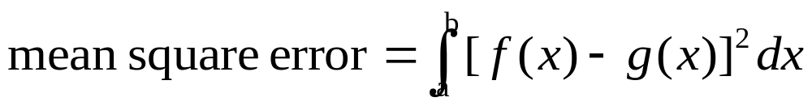
Measurements of error (3/6)
Geometrically (1) is the area between the graphs of f(x) and g(x) over the interval [a,b] (Figure 9.4.2); the greater the area, the greater the overall error.
While (1) is natural and appealing geometrically, most mathematicians and scientists generally favor the following alternative measure of error, called the mean square error.

Slide 8
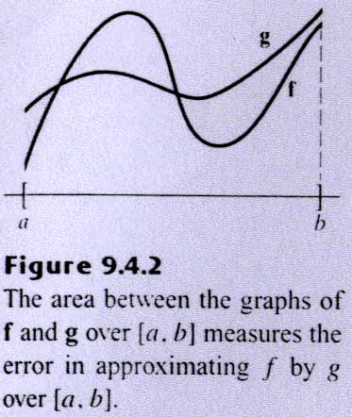
Figure 9.4.2
Go back

Slide 9
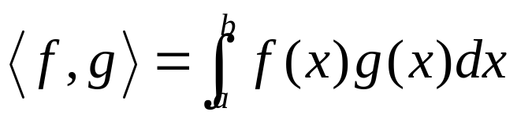
Measurements of error (4/6)
Mean square error emphasizes the effect of larger errors because of the squaring and has the added advantage that it allows us to bring to bear the theory of inner product spaces.
To see how, suppose that f is a continuous function on [a,b] that we want to approximate by a function g from a subspace W of C[a,b], and suppose that C[a,b] is given the inner product

Slide 10
Measurements of error (5/6)
It follows that
so that minimizing the mean square error is the same as minimizing ||f-g||.
Thus, the approximation problem posed informally at the beginning of this section can be restated more precisely as follows:

Slide 11
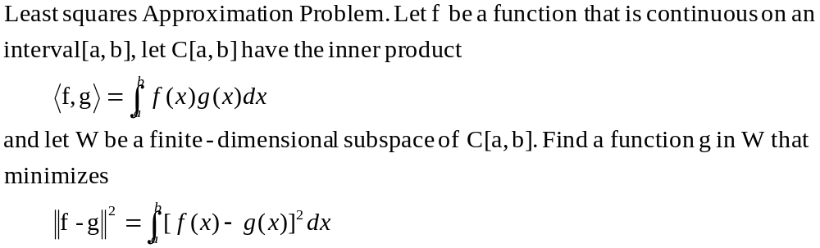
Least Square Approximation

Slide 12
Measurements of error (6/6)
Since ||f-g||² and ||f-g|| are minimized by the same function g, the preceding problem is equivalent to looking for a function g in W that is closest to f.
But we know from Theorem 6.4.1 that g=proj_{w}f is such a function (Figure 9.4.3). Thus, we have the following result.

Slide 13
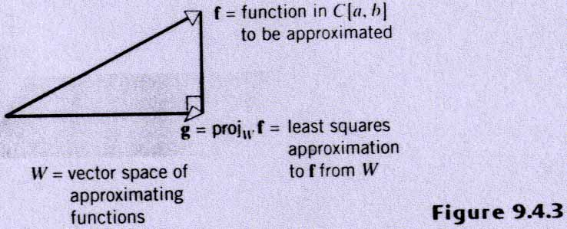
Figure 9.4.3
Go back

Slide 14
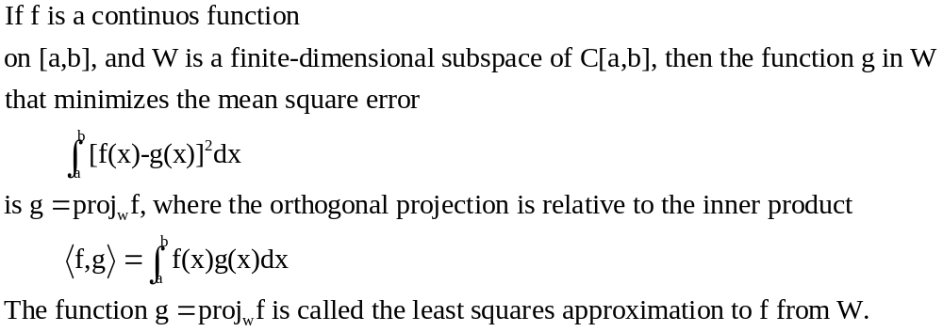
Solution of the least squares approximation problem

Slide 15
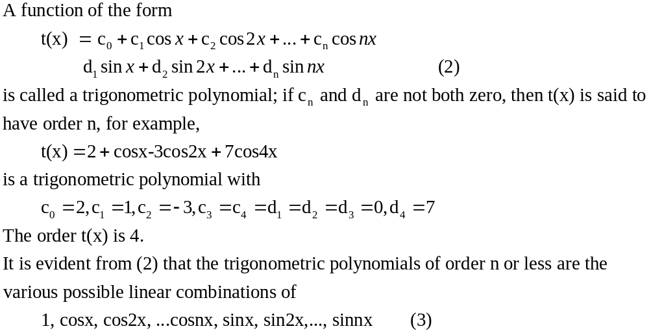
Fourier Series (1/4)

Slide 16
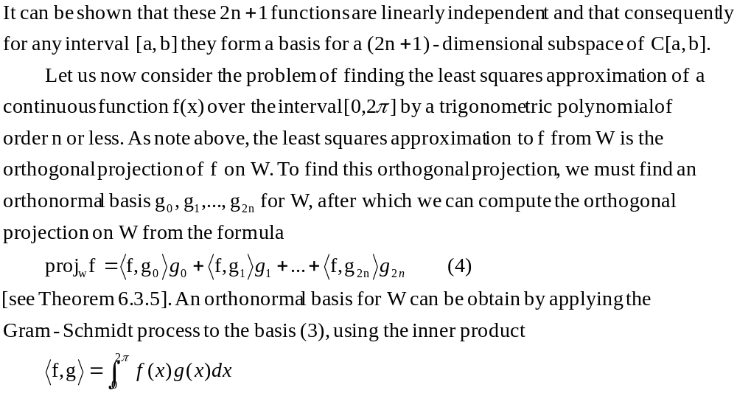
Fourier Series (2/4)

Slide 17
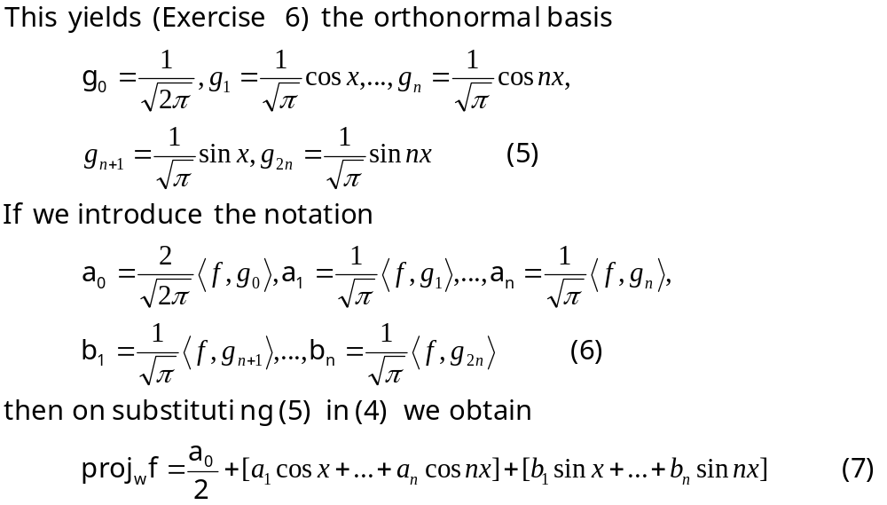
Fourier Series (3/4)

Slide 18
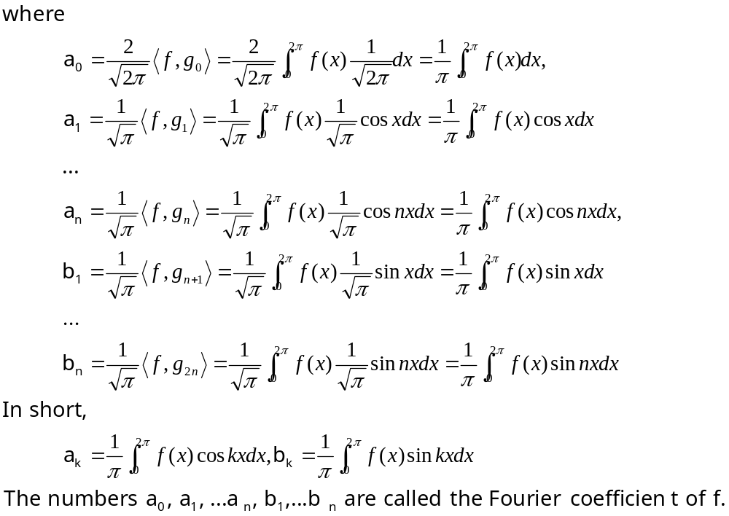
Fourier Series (4/4)

Slide 19
Example 1
Least squares approximations
Find the least squares approximation of f(x)=x on [0,2π] by
  A) a trigonometric polynomial of order 2 or less;
  B) a trigonometric polynomial of order n or less.

Slide 20
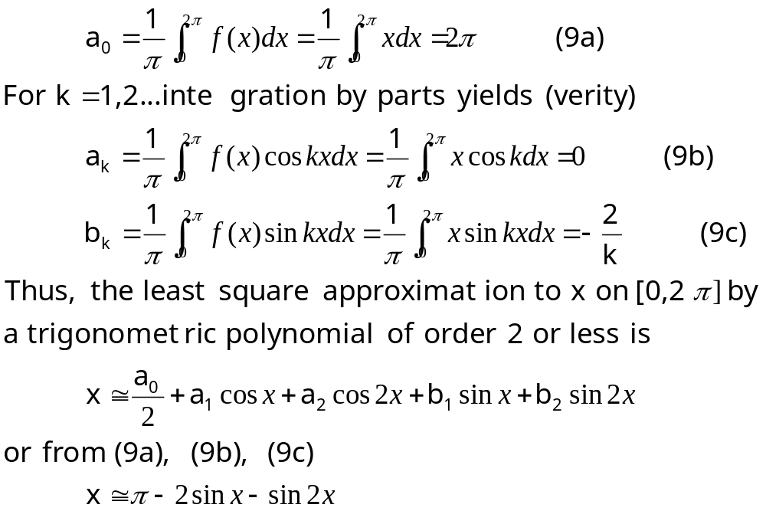
Solution (a)

Slide 21
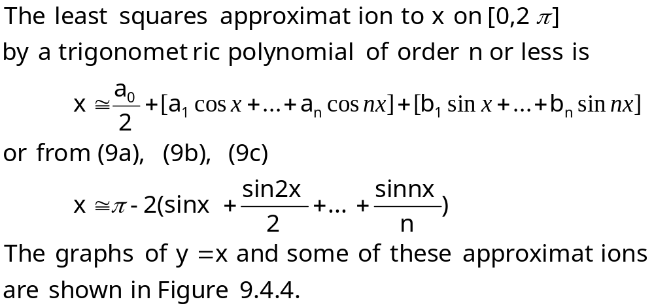
Solution (b) (1/2)
Figure 9.4.4

Slide 22
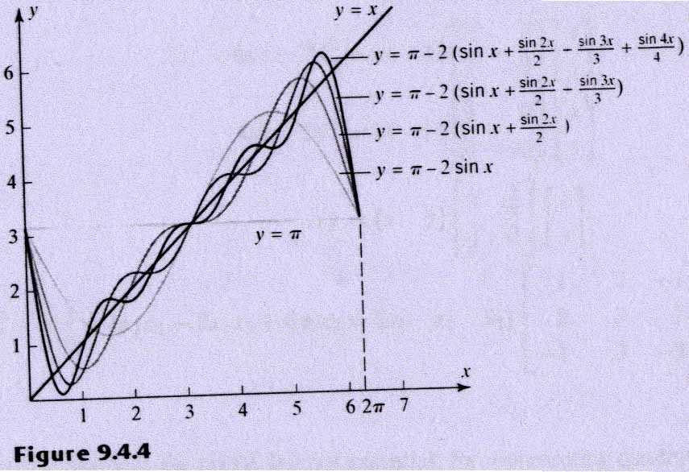
Figure 9.4.4
Go back

Slide 23
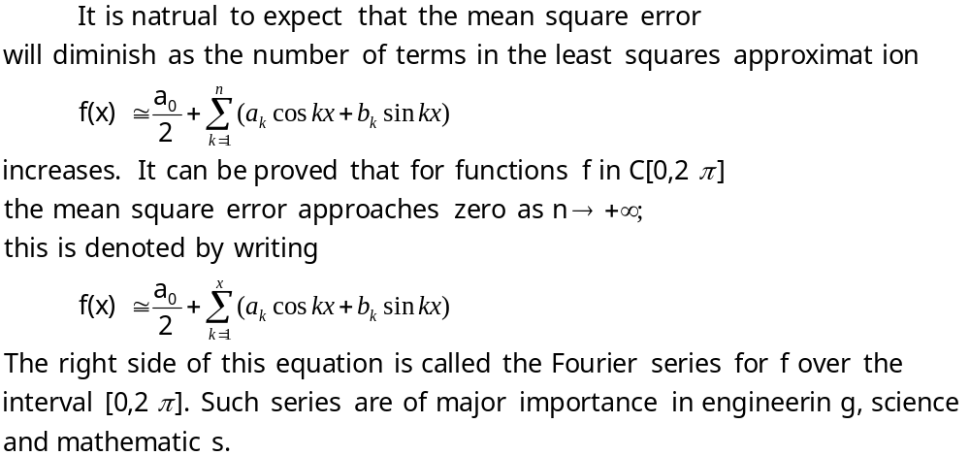
Solution (b) (2/2)

Slide 24
9.5 Quadratic forms
In this section we shall study functions in which the terms are squares of variables or products of two variables.
Such functions arise in a variety of applications, including geometry, vibrations of mechanical systems, statistics, and electrical engineering.

Slide 25
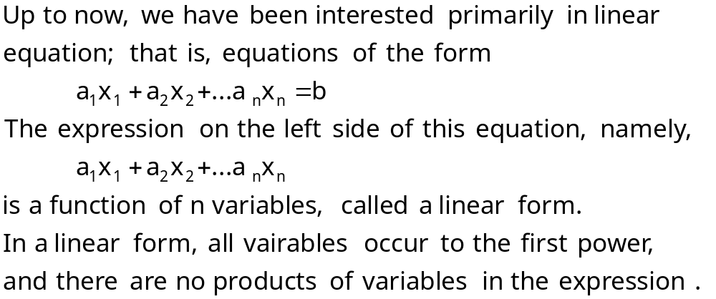
Quadratic forms (1/4)

Slide 26
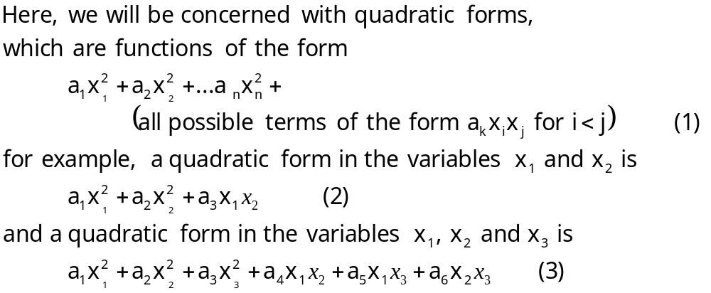
Quadratic forms (2/4)

Slide 27
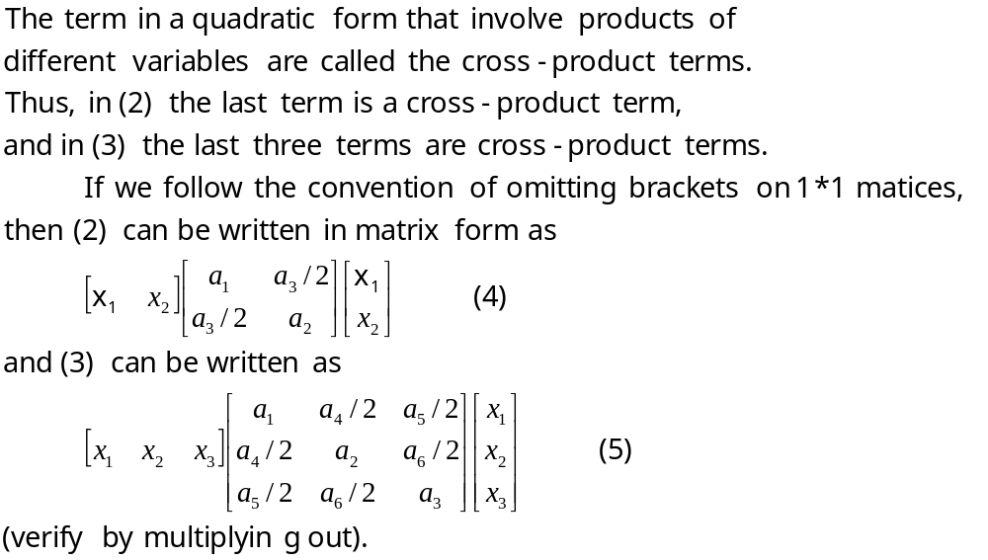
Quadratic forms (3/4)

Slide 28
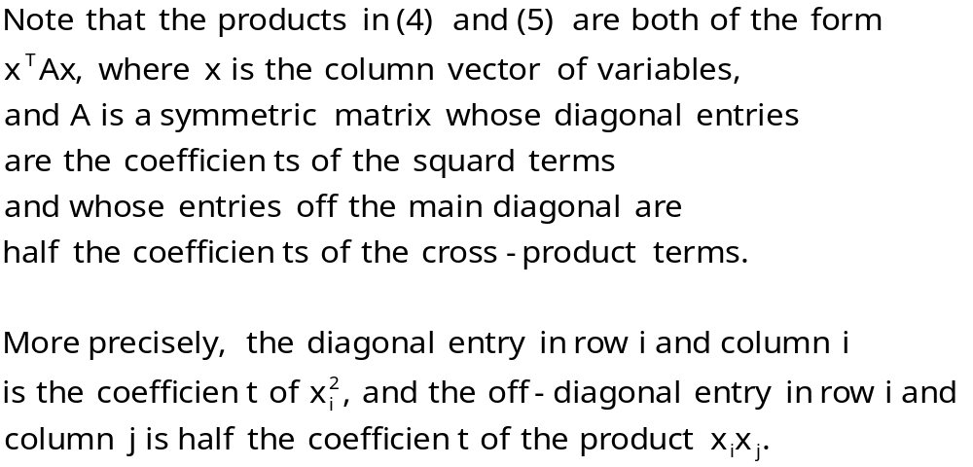
Quadratic forms (4/4)

Slide 29
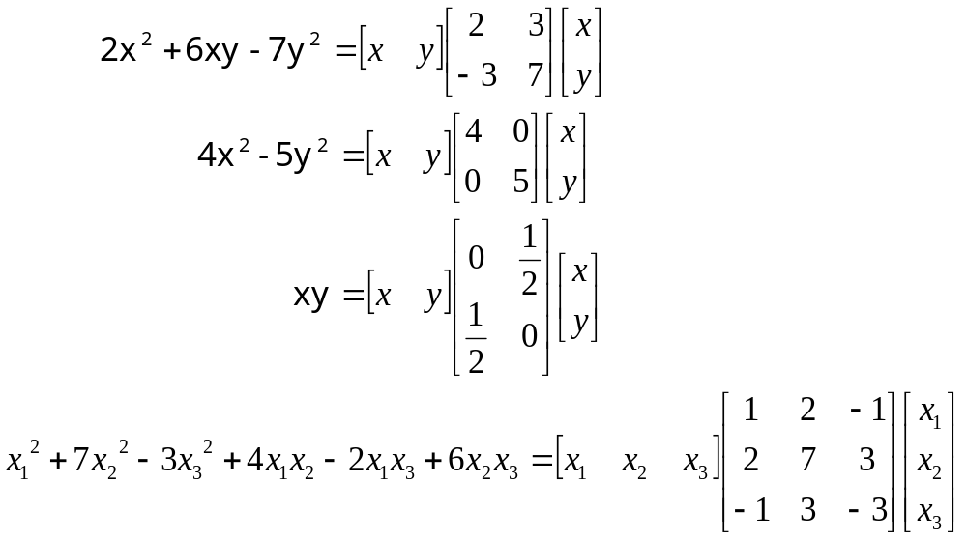
Example 1
Matrix Representation of Quadratic Forms

Slide 30

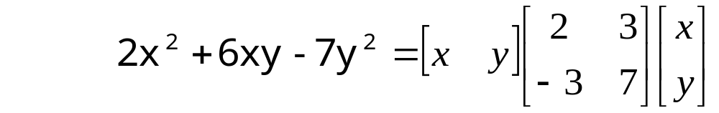
Symmetric matrices are useful, but not essential, for representing quadratic forms.
For example, the quadratic form 2x²+6xy-7y², which we represented in Example 1 as x^{T}Ax with a symmetric matrix A, can be written as
where the coefficient 6 of the cross-product term has been split as 5+1 rather than 3+3, as in the symmetric representation.

Slide 31
However, symmetric matrices are usually more convenient to work with, so it will always be understood that A is symmetric when we write a quadratic form as x^{T}Ax, even if not stated explicitly.
When convenient, we can use Formula (7) of Section 4.1 to express a quadratic form x^{T}Ax in terms of the Euclidean inner product as
If preferred, we can use the notation u∙v=<u,v> for the dot product and write these expression as
x^{T}Ax=Ax∙x or by symmetry of the dot product x^{T}Ax=x∙Ax
x^{T}Ax=x^{T(}Ax)=<Ax,x>=<x,Ax> (6)

Slide 32
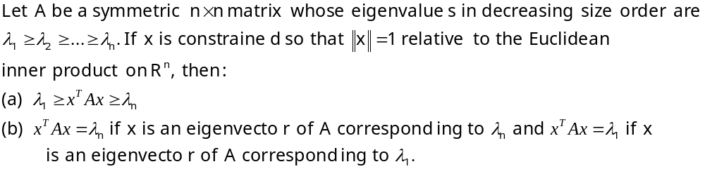
Theorem 9.5.1

Slide 33
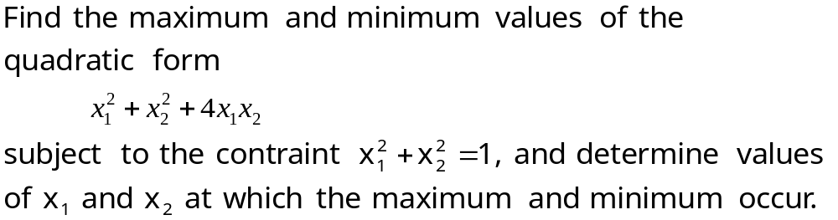
Example 2
Consequences of Theorem 9.5.1

Slide 34
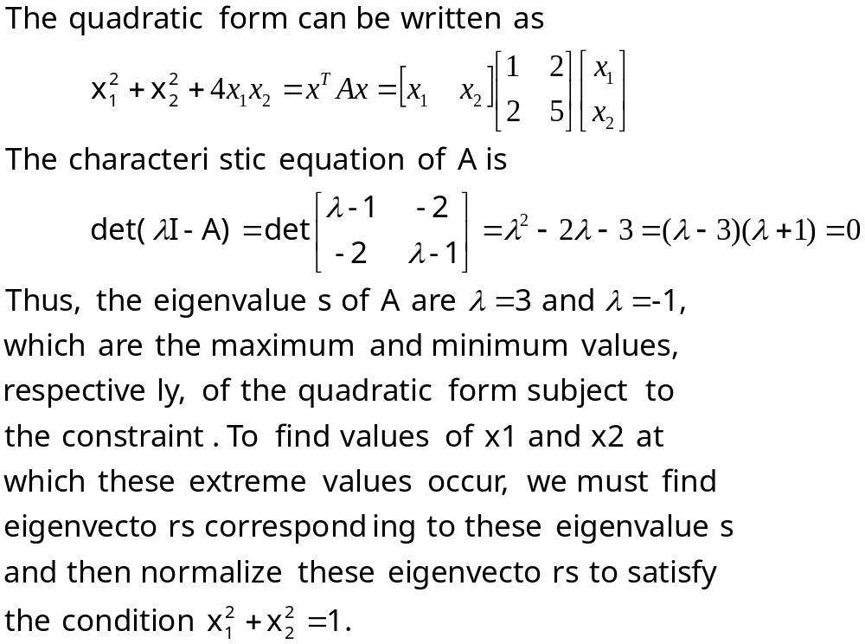
Solution

Slide 35
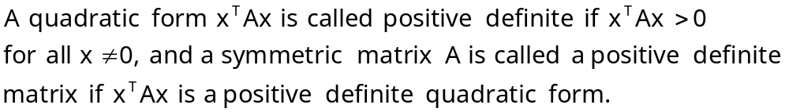
Definition

Slide 36
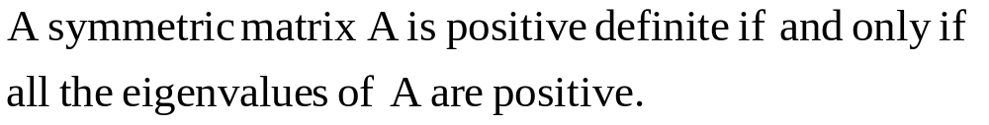
Theorem 9.5.2

Slide 37
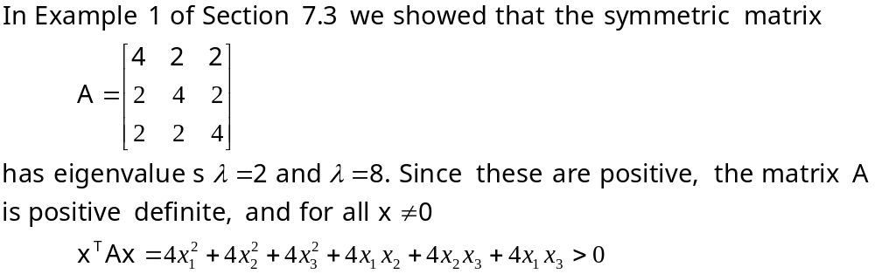
Example 3
Showing that a matrix is positive definite

Slide 38
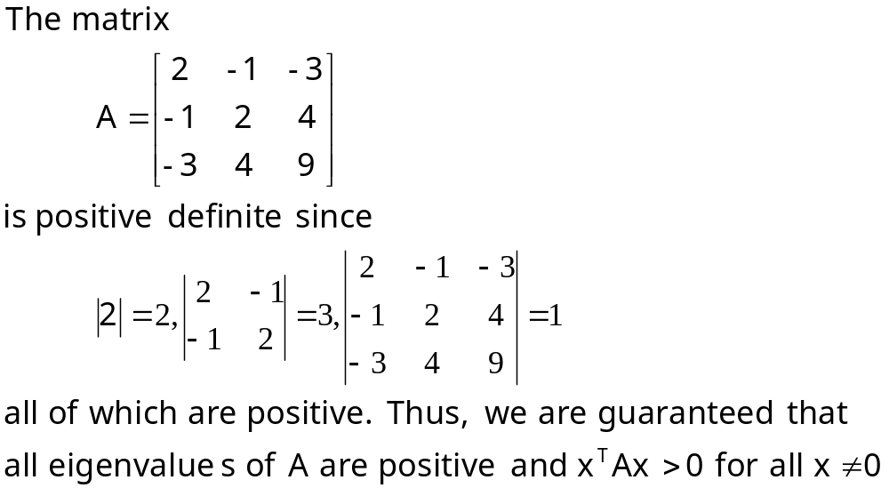
Example 4
Working with principle submatrices

Slide 39
Theorem 9.5.3

